Slide 1
BSCS-7th Semester
M. Arham
Lecturer
The University of Faisalabad

Slide 2
Compiler Construction
Course Code: CS-411
Lecture 01

Slide 3




www.tuf.edu.pk
unioffaisalabad
Credit Hours: 3(3-0)
Theory: Cr. Hr. 03
Practical: Cr. Hr. 00

Slide 4
Marking Scheme
www.tuf.edu.pk
unioffaisalabad
Mid Exam= 25 Marks
Final Exam= 40 Marks
Sessional = 35 Marks
  Assignment 1 (05)
  Assignment 2 (05)
  Assignment 3 (05)
  Quiz 1 (05)
  Quiz 2 (05)
  Presentations (10)
Total Marks: 100

Slide 5
www.tuf.edu.pk
unioffaisalabad
Advice…!!
Kindly read the book before and after the lecture, if some terms/ words are not covered in the lecture, if appear in exam it might not appear strange or out of course.

Slide 6
Content
Introduction to compiler
Application of Compiler

Slide 7
Natural Languages
What are Natural Languages?
How do you understand the languages?
If you know multiple languages then how can you recognize each of them ?
How you know which sentence is correct and which one is incorrect?

Slide 8
Programming Langugaes
What are programming Languages?
How do you understand t5he programming languages?
If you know multiple programming languages then how can you recognize each of them?
How do you know which syntax is correct and which one is incorrect?

Slide 9
Compiler
Definition:
A compiler is a program that translates code written in a high-level programming language (like C, C++, Java, or Python) into machine code, bytecode, or another lower-level language that a computer can understand and execute.
Source Code → Machine Code
  It takes your human-readable code and turns it into something your computer's processor can run directly.

Slide 10
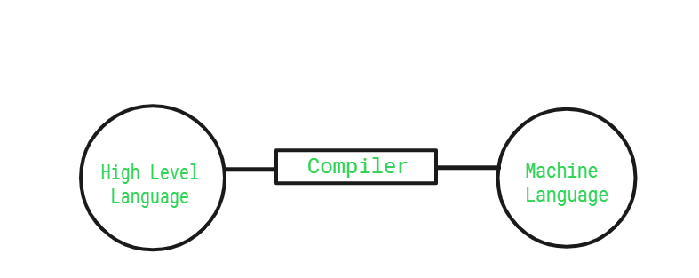
Compiler

Slide 11
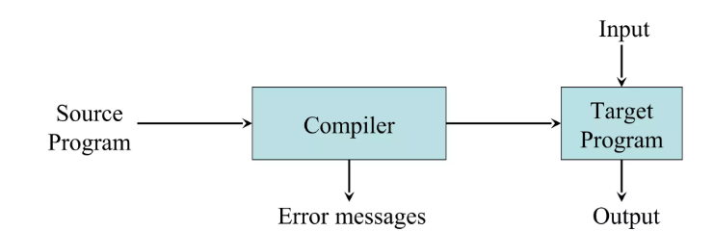
Compiler

Slide 12
Why we study compilers?
Application of a wide range of theoretical techniques
  Data structures
  Theory of computations
  Algorithms
  Computer architecture
Better understanding of programming languages.

Slide 13
Features of compilers
Correctness
  preserve the meaning of the code
Speed of target code
Recognize legal and illegal program.
Speed of compilation
Good error reporting/handling
Cooperation with the debugger
Manage storage of all variables and codes.
Support for separate compilation

Slide 14
Application of Compiler
Converts source code (C, C++, Java) into executable programs
Used in IDEs and build systems (e.g., Visual Studio, Eclipse)
Optimizes code for performance
Debugging tools rely on compiler metadata
Static code analysis

Slide 15
www.tuf.edu.pk
unioffaisalabad
Advice…!!
Kindly read the book before and after the lecture, if some terms/ words are not covered in the lecture, if appear in exam it might not appear strange or out of course.

